Slide 1

Document Object Model

Slide 2
Document Object Model
In this section we will learn about the Document Object Model (DOM)
The DOM will allow us to interface our Javascript code to interact with HTML and CSS

Slide 3
Document Object Model
Browsers will construct the DOM, which basically means storing all the HTML tags as Javascript objects.
Let’s see a simple example...

Slide 4
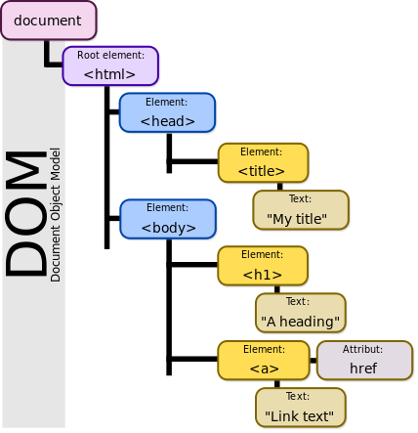

Document Object Model
<! DOCTYPE html>
<html>
<head>
<title> My Title </title>
</head>
<body>
<h1>A heading </h1>
<a href= “websiteLink”>Link text</a>
</body>

Slide 5
Document Object Model
We can see the DOM of any website.
Go to a website and in the console type:
document
That will return the HTML text of the page. To see the actual objects use:
console.dir(document)

Slide 6
Document Object Model
This DOM will allow us to use Javascript to interact with the web page.
The DOM is enormous, most developers won’t use all the properties.
We will cover the common objects used, but be prepared for the unknown!

Slide 7
Document Object Model
Let’s explore this in the browser!
Afterwards in the next lecture we will go through an example of using Javascript with the DOM.

Slide 8
Part 1 -DOM Interaction
Using Javascript to interact with DOM elements!

Slide 9
Document Object Model
In this lecture we will begin to see examples of how to grab HTML elements from the DOM.
The HTML elements are properties of the DOM

Slide 10
Document Object Model
We’ll cover how to grab large groups of elements, like the entire body or head of the HTML
And then focus on grabbing specific HTML items, like classes or ids.

Slide 11
Document Object Model
Here are some important document attributes:
document.URL
document.body
document.head
document.links

Slide 12
Document Object Model
There are many methods for grabbing elements from the DOM:
document.getElementById()
document.getElementByClassName()
document.getElementsByTagName()
document.querySelector()
document.querySelectorAll()

Slide 13
Document Object Model
Check out the relevant files:
Part1_MainPage.html
Part1_Color_Changer.js
We will start by disconnecting the html file and exploring it a bit manually, then we will code out a complex example.

Slide 14
Document Object Model
Let’s explore these various methods!

Slide 15
Document Object Model
Once you have grabbed an element, you can interact with it!
myvariable.style.color (Many CSS options)
myvariable.textContent
myvariable.innerHTML
myvariable.getAttribute()
myvariable.setAttribute()

Slide 16
Document Object Model
Let’s explore these various methods!

Slide 17
Part 2 -
Content Interaction
Document Object Model

Slide 18
Document Object Model
In this lecture we will see more examples of how to interact with the HTML from the DOM.
We will show how to change text, HTML code, and attributes.

Slide 19
Document Object Model
Relevant files are:
Part2_Content.html
Part2_Interact.js
Let’s get started!

Slide 20
Part 3 - DOM Events
Using Javascript to trigger on events!

Slide 21
Document Object Model
We don’t always want to have to specify beforehand how to interact with the DOM
Many times we only want the interaction to occur on a particular event, such as a click or a hover.

Slide 22
Document Object Model
We achieve this by adding an Event Listener
The javascript will be “listening” for an event to occur and then execute a function when it happens.
Let see some example code!

Slide 23
Document Object Model
Listening for an event looks like this:
myvariable.addEventListener(event,func);
An example:
var head = document.querySelector(‘h1’);
head.addEventListener(“click”,changeColor);

Slide 24
Document Object Model
There are many, many possible events!
Clicks
Hovers
Double Clicks
Drags
Much More!
https://developer.mozilla.org/en-US/docs/Web/Events

Slide 25
Document Object Model
Let’s explore these events!

Slide 26
Part 4 - Game Project
Document Object Model

Slide 27
Document Object Model
It is time to get some practice with the DOM!
We will be creating a very simple tic tac toe game interface.
You have two options on the approach for this project.

Slide 28
Document Object Model
First Option
Try to replicate the game completely on your own.
Second Option
Follow along with the “solution” lecture for a code-along session.

Slide 29
Document Object Model
I recommend you try it at least once on your own to get some practice of seeing something and then trying to replicate it on your own, a great skill to have!
Let’s start by seeing what the final game looks like!

Slide 30
Part 4 - Game Project
Solutions
Document Object Model

